Slide 1
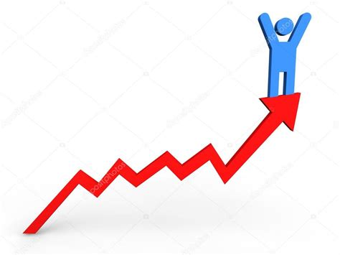
Leveraged investing analysis
Kasra Rezaee

Slide 2
Simulation of Leveraged Funds
Based on the historical values of Vanguard 500 Index Fund Investor Shares (VFINX), Vanguard Long-Term Treasury Fund Investor Shares (VUSTX), and NASDAQ 100 (^NDX)
Calculate daily changes of each fund
Deduct daily fees (2% annualized to be conservative) from changes and multiply by 3,
Recalculate the price by cumulating the new daily change

Slide 3
Backtest scenario
Backtest for all the combinations of
Starting year: 1987 to 2018
End year: start+2 to 2020
equity ratio in fund: 0% to 100% in 10% increment
equity combination: 60% UPRO (S&P500 x3) and 40% TQQQ (NASDAQ100 x3)
Nasdaq 100 companies are technology and former start-up companies, but they are also included in S&P500. this will effectively increase the weight toward technology companies
Rebalance every month

Slide 4
Terms
Max drawdown – the maximum drop% from the last peak
CAGR - Compound annual growth rate. The rate of return that would be required for an investment to grow from its beginning balance to its ending balance
Sharpe ratio - return of an investment compared to its risk

Slide 5
Benchmark: Vanguard 500 Index Fund Investor + Vanguard Long-Term Treasury Fund Investor
100% 500 Index Fund
60% 500 Index Fund , 40% Long-Term Treasury Fund

Slide 6
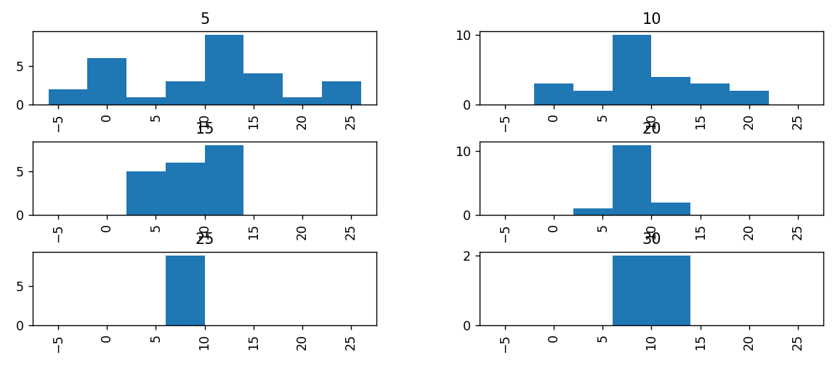
Benchmark 100% 500 Index: CAGR

Slide 7
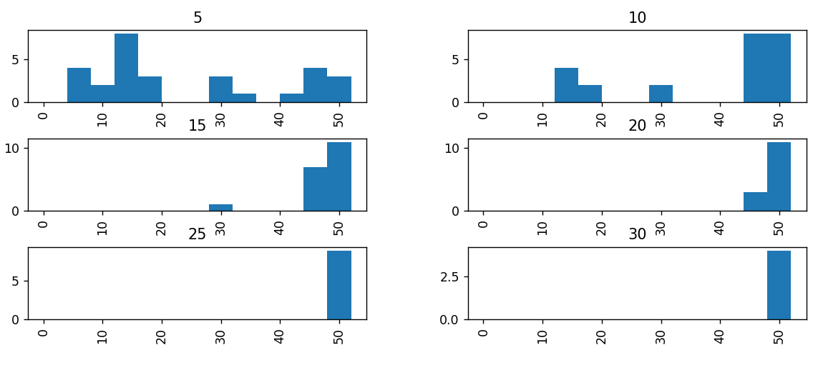
Benchmark 100% 500 Index: Max Drawdown

Slide 8
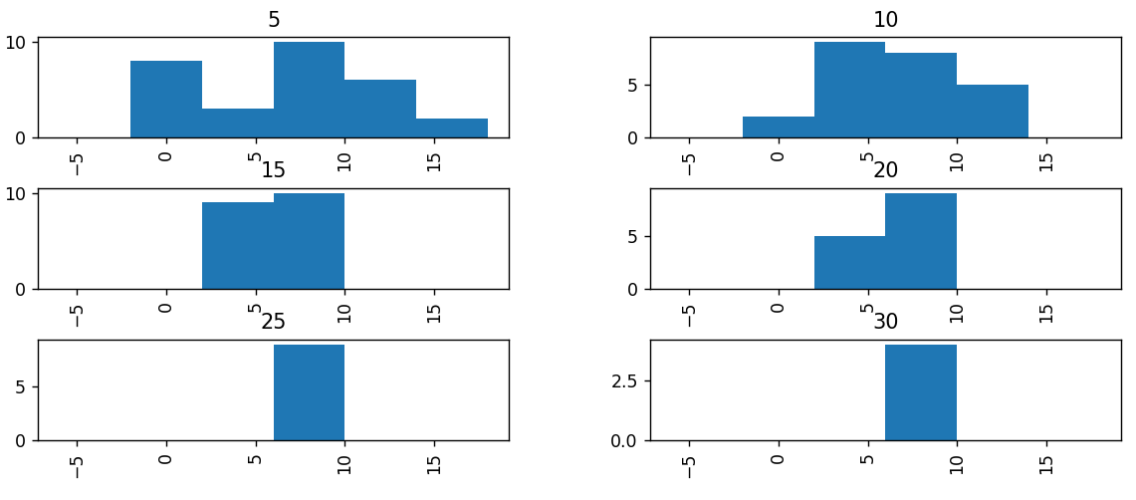
Benchmark 60% 500 Index, 40% Long-Term Treasury: CAGR

Slide 9
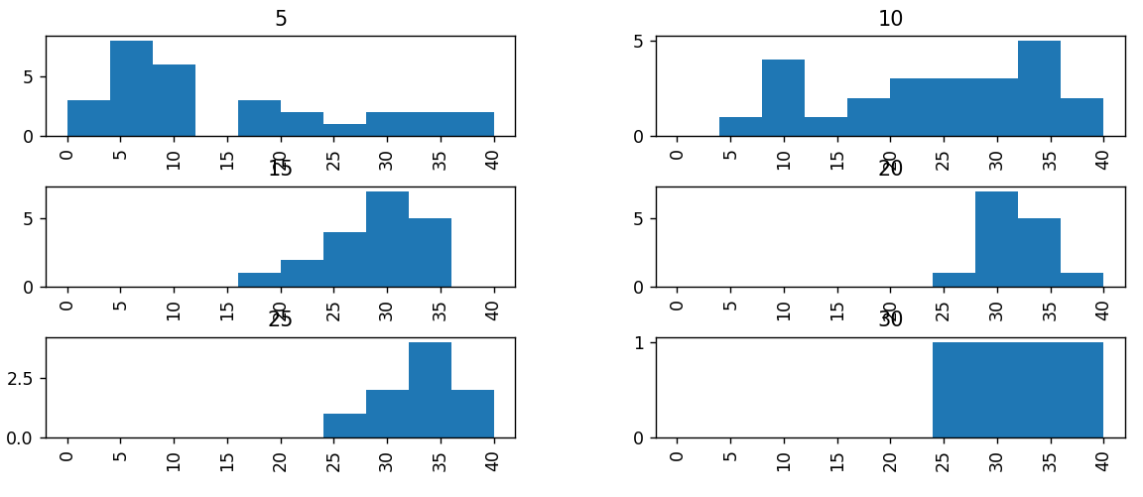
Benchmark 60% 500 Index, 40% Long-Term Treasury: Max Drawdown

Slide 10
Backtest of the leveraged funds

Slide 11
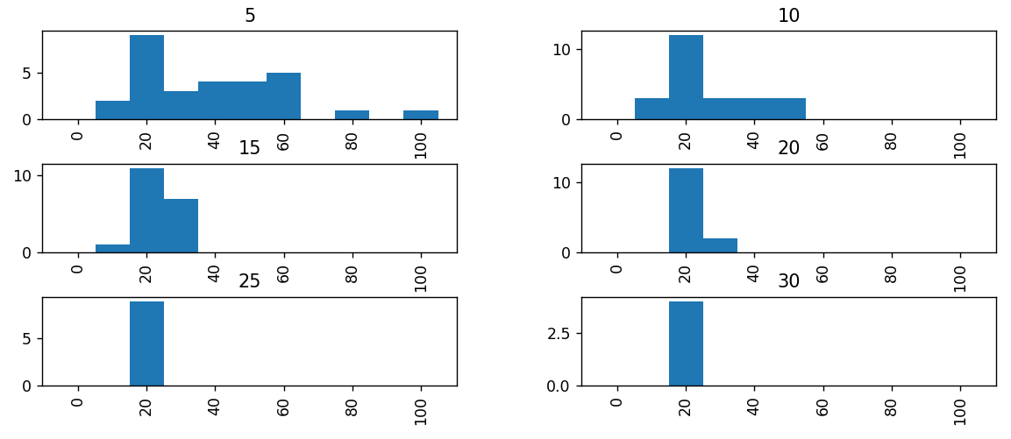
Histogram of best % equity for each starting year that minimize Max Drawdown, grouped by horizon

Slide 12
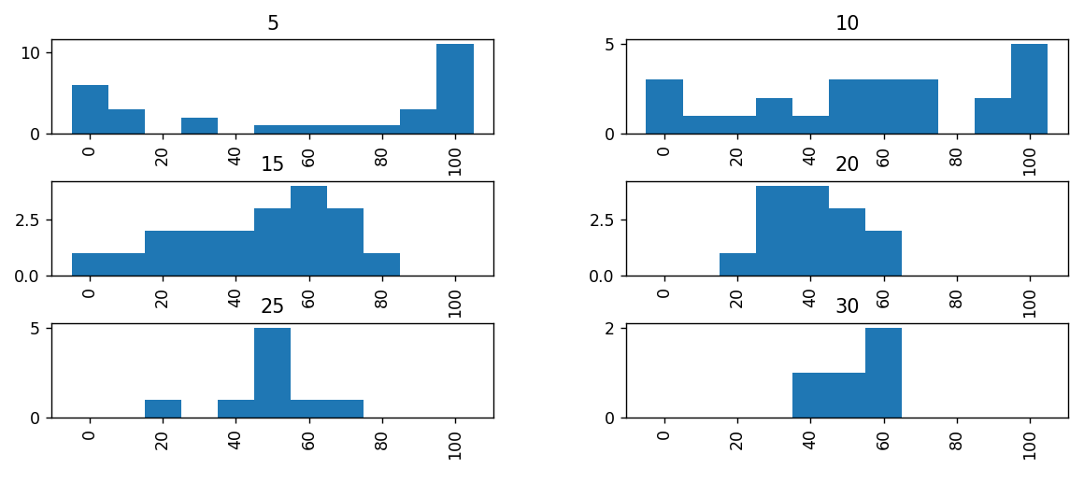
Histogram of best % equity for each starting year that maximize CAGR

Slide 13
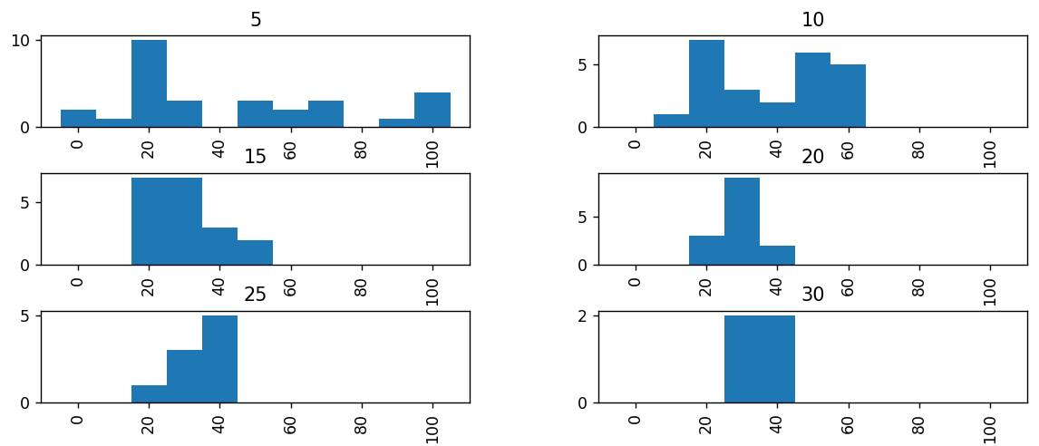
Histogram of best % equity for each starting year that maximize Sharpe ratio

Slide 14
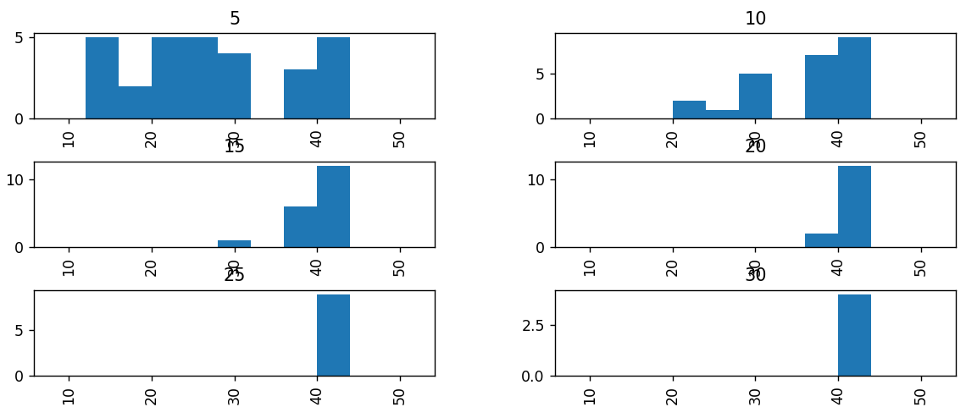
Histogram of Max Drawdown for 40 % equity the 40% drop is the dot com bubble popping.

Slide 15
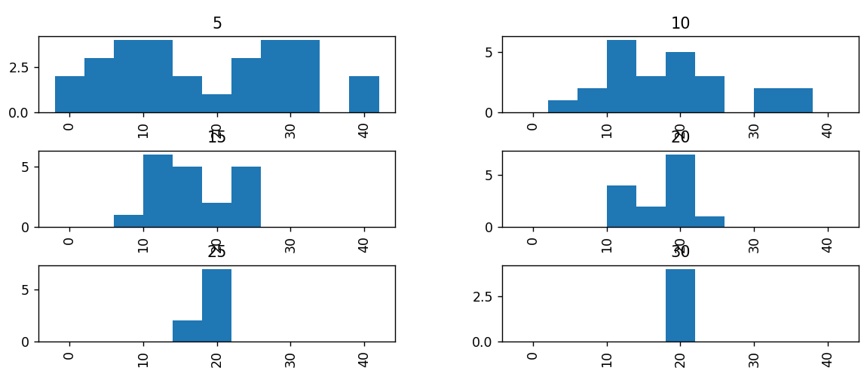
Histogram of CAGR for 40 % equity

Slide 16
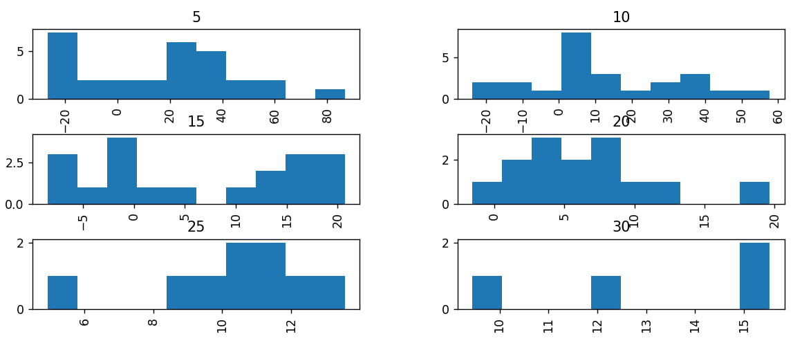
Histogram of CAGR for 100 % equity be mindful of varying x axis bins

Slide 17
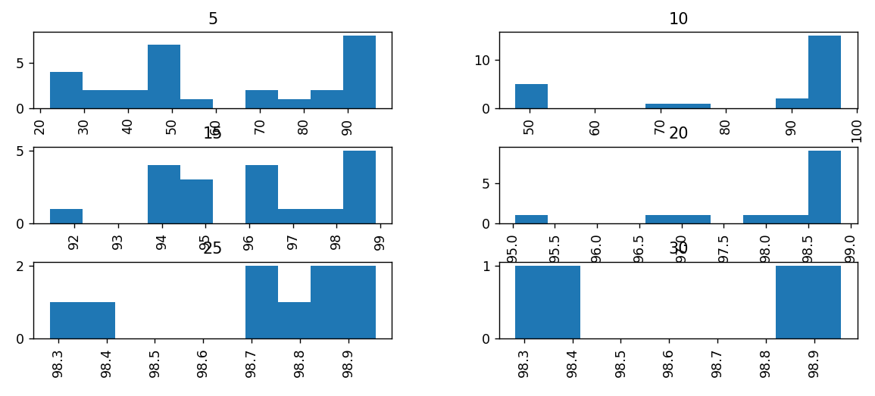
Histogram of Max Drawdown for 100 % equity be mindful of varying x axis bins

